Slide 1
Java Collection
Addison Java Virtual Machine meet-up

Slide 2
Collection
A collection is an object that groups multiple elements into a single unit
Java Collection API provides interfaces and its implemented classes for storing and manipulating data.
Java Collection is a generic type, which only accept elements of non-primitive type.
Example – src/generalCollection

Slide 3
Collection Components
Interface
Implementation - classes
Algorithms

Slide 4
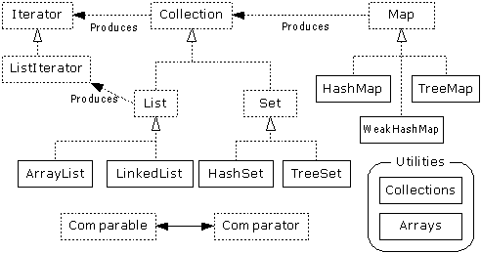
General Collection Frame
Source: Interfaces, Implementations, and Algorithms from Thinking in Java

Slide 5
Collection Usage
Declare variable of interface is preferable to classes
Java Interface such as Collection, List, Set, Map cannot initiate. Only their implementation can be use to initiate variable
Example:

Slide 6
Common Collection Methods
public interface Collection<E> extends Iterable<E> {
// Basic operations
int size();
boolean isEmpty();
boolean contains(Object element);
boolean add(E element); //optional
boolean remove(Object element); //optional
Iterator<E> iterator();
// Bulk operations
boolean containsAll(Collection<?> c);
boolean addAll(Collection<? extends E> c); //optional
boolean removeAll(Collection<?> c); //optional
boolean retainAll(Collection<?> c); //optional
void clear(); //optional
// Array operations
Object[] toArray();
<T> T[] toArray(T[] a);
}

Slide 7
List Interface – Common Methods
public interface List<E> extends Collection<E> {
// Positional access
E get(int index);
E set(int index, E element); //optional
boolean add(E element); //optional
void add(int index, E element); //optional
E remove(int index); //optional
boolean addAll(int index,
Collection<? extends E> c); //optional
// Search
int indexOf(Object o);
int lastIndexOf(Object o);
// Iteration
ListIterator<E> listIterator();
ListIterator<E> listIterator(int index);
// Range-view
List<E> subList(int from, int to);
}
ArrayList
LinkedList
Example (note: remove method)

Slide 8
ArrayList Class
Implement all List’s methods
Store data in an array
Default initial of size is 10 elements
Refill size by double
trim() methods can be used to cut resize array to exact number of elements.
Example:

Slide 9
ArrayList
Object get(int index)
Object set(int index, Object element)
void ensureCapacity(int minCapacity)

Slide 10
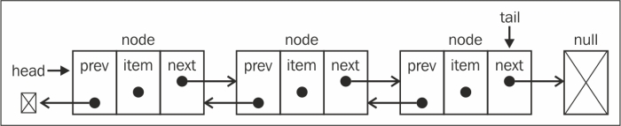
LinkedList
Implement all List methods:
Use Double List data structure
Element get(int index)

Slide 11
Comparason ArrayList and LinkedList
Usage | ArrayList | LinkedList
Instant access | Yes get(int index) has O(1) | No get(int index) has O(n)
Good for inserting, add, delete and resize | No | Yes
Support Sorting | Yes | Yes

Slide 12
Sorting
Comparable interface:
int compareTo(Object o)
Comparator Interface:
int compare(Object ob1, Object ob2)
public int compare(Squirrel s1, Squirrel s2) {
Comparator<Squirrel> c = Comparator.comparing(s -> s.getSpecies());
c = c.thenComparingInt(s -> s.getWeight());
return c.compare(s1, s2);
}
Example:

Slide 13
Set
Implement mathematical model of set:
All elements in set are unique
Set has 2 immplementation:
Treeset Classes
HashSet Classes
Example:

Slide 14
HashSet
Unorder set
Use hash table to store elements by using hashCode()
Instant access to element
Need to override hashCode() and ensure that it is compatible with equals()
Example:
boolean add(Object o)

Slide 15
TreeSet
Order Set
Use Binary Tree data structure to store element
Elements have to be comparable.
TreeSet always keep all elements in order.
Example:
boolean add(Object o)

Slide 16
Map Interface
Store element as pair: (Key,Value)
Key cannot be duplicate
Values can equal

Slide 17
Map common methods
Object put(Object key, Object value)
Object get(Object key)
Object remove(Object key)
boolean containsKey(Object key)
boolean containsValue(Object value)
int size()
boolean isEmpty()

Slide 18
HashMap
Map using hashTable to store Key and Values
Map is not order

Slide 19
TreeMap
Use Binary Tree to store Data
All Key are inserted in order

Slide 20
Comparable vs Comparator
CompareTo(o)
CompareTo has to be compatible with equals() and hashCode()
Compare(o1,o2) use in case we need to sort using different categories

